Slide 1
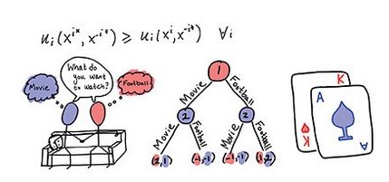
Game Theory
[Continued]
From
Mathematical Optimization and Economic Theory
Jacob Wyngaard

Slide 2
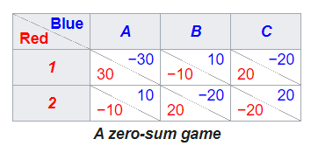

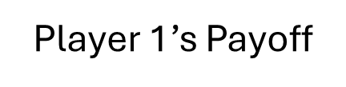
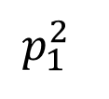
Zero Sum Game with 2 x 3 Payoff Matrix
Player 1’s Payoff
B
C
20
30
3
6
-10
-2
The Saddle Point
-10
-20
$$p_{1}^{2}$$
-4
20
5
4
$$\frac{8}{17}$$
A

Slide 3

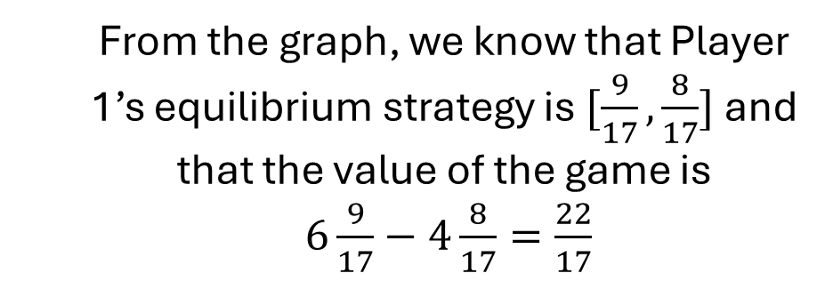



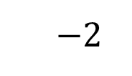
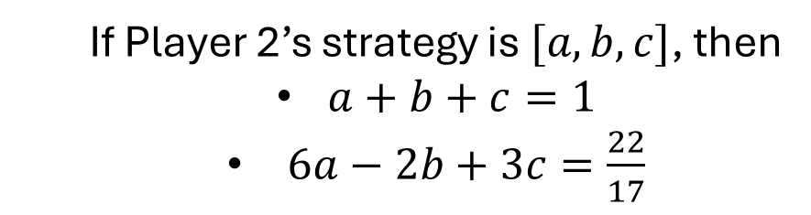

Zero Sum Game with 2 x 3 Payoff Matrix
Player 1’s Payoff
From the graph, we know that Player 1’s equilibrium strategy is $[\frac{9}{17},\frac{8}{17}]$ and that the value of the game is
$6\frac{9}{17}−4\frac{8}{17}=\frac{22}{17}$
$$6$$
B
C
$$3$$
The Saddle Point
How do we find Player 2’s best strategy?
$$p_{1}^{2}$$
If Player 2’s strategy is $[a,b,c]$, then
$a+b+c=1$
$6a−2b+3c=\frac{22}{17}$
$$\frac{8}{17}$$
$$−2$$
A
$$−4$$
Three unknowns, two constraints

Slide 4

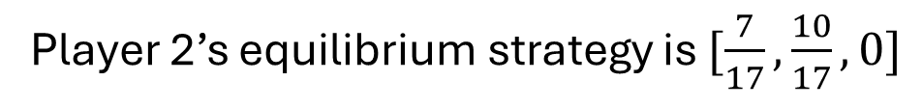



Zero Sum Game with 2 x 3 Payoff Matrix
Player 1’s Payoff
$a+b+c=1$
$6a−2b+3c=\frac{22}{17}$
$$6$$
B
What if we could eliminate one of Player 2’s strategies?
C
$$3$$
Line C is never part of the minimum line $⇒c=0$
The Saddle Point
$$p_{1}^{2}$$
Now we have the system of equations:
$$\frac{8}{17}$$
$$−2$$
$a+b=1$
$6a−2b=\frac{22}{17}$
A
$$−4$$
Player 2’s equilibrium strategy is $[\frac{7}{17},\frac{10}{17},0]$

Slide 5
Zero Sum Game with 2 x 3 Payoff Matrix
How do we eliminate strategy C using the payoff matrix?
We are allowed to eliminate strictly dominated strategies; the dominant strategies can be mixed strategies!
20
30
3
6
-10
-2
-10
-20
-4
20
5
4
If strategy C can be strictly dominated by a convex hull of other strategies, then C can be eliminated

Slide 6
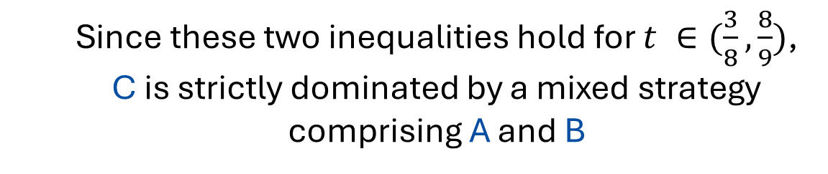

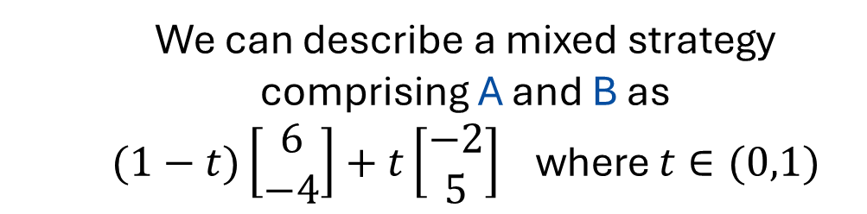
Zero Sum Game with 2 x 3 Payoff Matrix
We can describe a mixed strategy comprising A and B as
$(1−t)\left[\begin{matrix}6 \\ −4\end{matrix}\right]+t\left[\begin{matrix}−2 \\ 5\end{matrix}\right]$ where $t∈(0,1)$
For this mixed strategy to dominate C, the following two inequalities must hold:
20
30
3
6
-10
-2
-10
-20
$6\left(1−t\right)−2t<3$
$−4\left(1−t\right)+5t<4$
-4
20
5
4
Since these two inequalities hold for $t ∈(\frac{3}{8},\frac{8}{9})$, C is strictly dominated by a mixed strategy comprising A and B

Slide 7
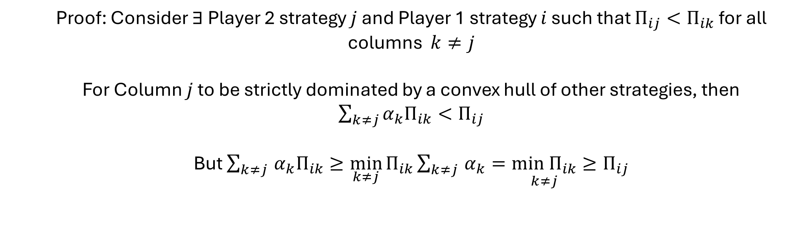
Zero Sum Game with 2 x 3 Payoff Matrix
Does every zero-sum game with a 2 x 3 payoff matrix have a Player 2 strategy that’s strictly dominated by a convex hull of the other strategies?
Claim: A Player 2 strategy cannot be strictly dominated if it contains a row minimum
Proof: Consider $∃$Player 2 strategy $j$ and Player 1 strategy $i$ such that $Π_{ij}<Π_{ik}$ for all columns $k≠j$
For Column $j$ to be strictly dominated by a convex hull of other strategies, then $\sum_{k≠j}{α_{k}Π_{ik}}<Π_{ij}$
But $\sum_{k≠j }{α_{k}Π_{ik}}≥\min_{k≠j}{Π_{ik}\sum_{k≠j }{α_{k}}=\underset{k≠j}{min Π_{ik}}}≥Π_{ij}$

Slide 8
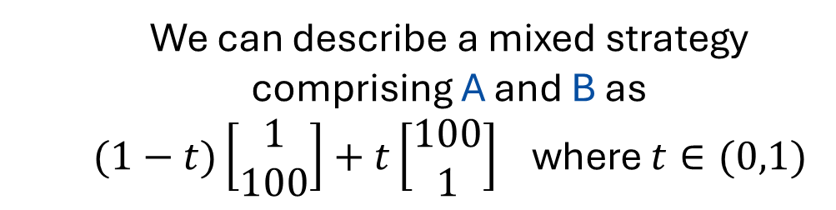
Zero Sum Game with 2 x 3 Payoff Matrix
Does every zero-sum game with a 2 x 3 payoff matrix have a Player 2 strategy that’s strictly dominated by a convex hull of the other strategies?
Because A and B contain row minimums, the only strategy that could be strictly dominated in this example is C
20
30
2
1
-10
100
-10
-20
100
20
1
3
We can describe a mixed strategy comprising A and B as
$(1−t)\left[\begin{matrix}1 \\ 100\end{matrix}\right]+t\left[\begin{matrix}100 \\ 1\end{matrix}\right]$ where $t∈(0,1)$

Slide 9
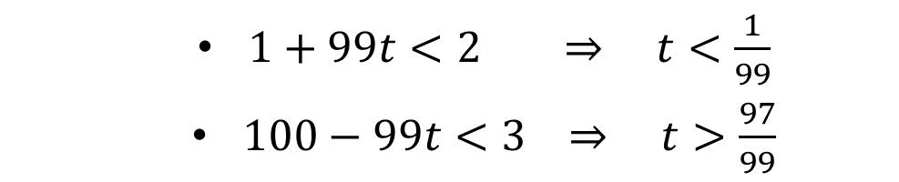

Zero Sum Game with 2 x 3 Payoff Matrix
For a mixed strategy of A and B to dominate C, the following two inequalities must hold:
$\left(1−t\right)+100t<2$
$100\left(1−t\right)+t<3$
20
30
2
1
-10
100
But this requires that:
-10
-20
100
20
1
3
$1+99t<2 ⇒ t<\frac{1}{99}$
$100−99t<3 ⇒ t>\frac{97}{99}$
No mixed strategy of A and B to dominates C!

Slide 10






Zero Sum Game with 2 x 3 Payoff Matrix
How do we find the Nash equilibrium for this game?
Player 1’s Payoff
A
$$6$$
B
20
$$3$$
30
2
1
-10
100
C
-10
-20
100
20
1
3
$$p_{1}^{2}$$
$$.98$$
$$−2$$
Player 1’s Strategy: $[.02,.98]$
At Nash Equilibrium

Slide 11


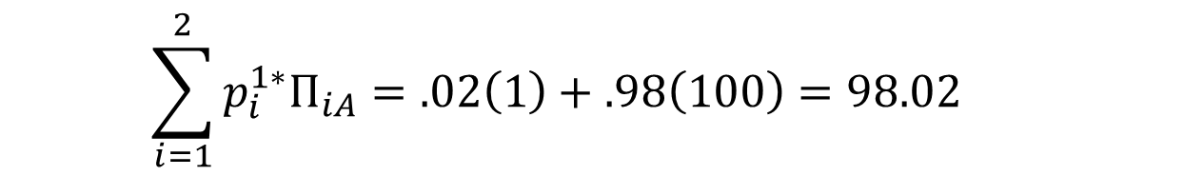
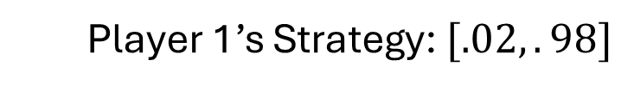
Zero Sum Game with 2 x 3 Payoff Matrix
We now use the Strong Minimax Theorem:
Either $\sum_{i=1}^{m}{p_{i}^{1∗}Π_{ij}=V}$ or $p_{j}^{2∗}=0$ for $j=A,B,C$
Player 1’s Strategy: $[.02,.98]$
$$\sum_{i=1}^{2}{p_{i}^{1∗}Π_{iA}=.02\left(1\right)+.98\left(100\right)=98.02}$$
20
30
2
1
-10
100
-10
-20
$$\sum_{i=1}^{2}{p_{i}^{1∗}Π_{iB}=.02\left(100\right)+.98\left(1\right)=2.98}$$
100
20
1
3
$$\sum_{i=1}^{2}{p_{i}^{1∗}Π_{iC}=.02\left(2\right)+.98\left(3\right)=2.98}$$

Slide 12
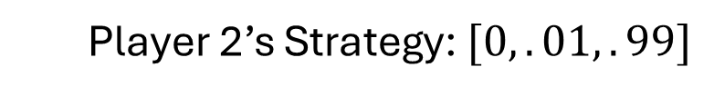
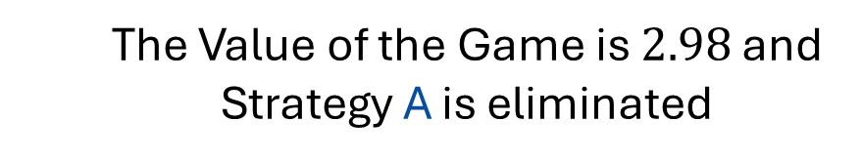
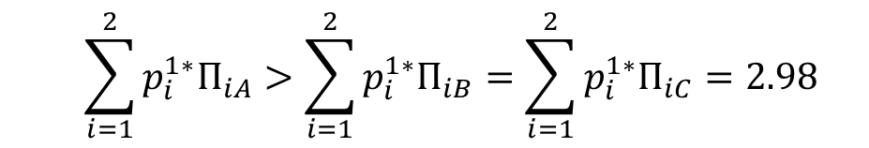
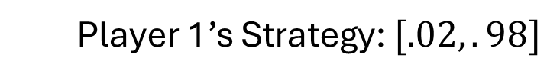
Zero Sum Game with 2 x 3 Payoff Matrix
Player 1’s Strategy: $[.02,.98]$
$$\sum_{i=1}^{2}{p_{i}^{1∗}Π_{iA}}>\sum_{i=1}^{2}{p_{i}^{1∗}Π_{iB}=\sum_{i=1}^{2}{p_{i}^{1∗}Π_{iC}}=2.98}$$
The Value of the Game is $2.98$ and Strategy A is eliminated
20
30
2
1
-10
100
-10
-20
100
20
1
3
Player 2 chooses their strategy to make Player 1’s payoff consistent across strategy
Player 2’s Strategy: $[0,.01,.99]$

Slide 13
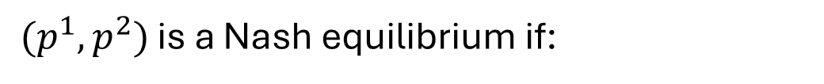
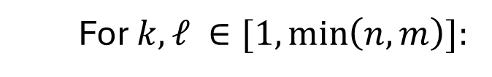
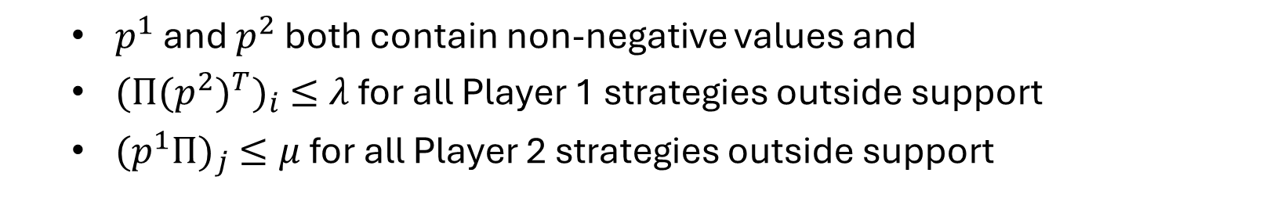
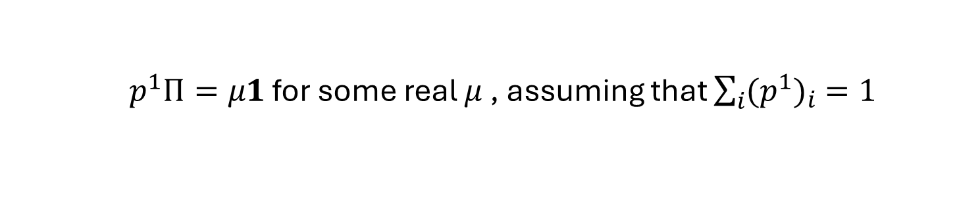
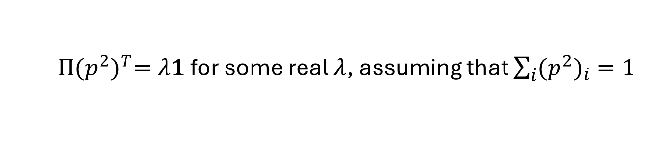
Finding Nash Equilibria in General
The Python library nashpy has three methods of finding equilibria:
Support Enumeration
For $k,ℓ ∈[1, \min\left(n,m\right)]:$
For all possible ways to select $k$ strategies for Player 1 and $ℓ$ strategies for Player 2:
Solve the indifference equations:
$Π{(p^{2})}^{T}=λ1$ for some real $λ$, assuming that $\sum_{i}{{(p^{2})}_{i} =1}$
$p^{1}Π=μ1$ for some real $μ$ , assuming that $\sum_{i}{{(p^{1})}_{i} =1}$
$(p^{1},p^{2})$ is a Nash equilibrium if:
$p^{1}$ and $p^{2}$ both contain non-negative values and
${(Π{(p^{2})}^{T})}_{i} ≤λ$ for all Player 1 strategies outside support
${(p^{1}Π)}_{j} ≤μ$ for all Player 2 strategies outside support

Slide 14


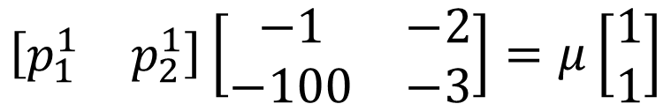
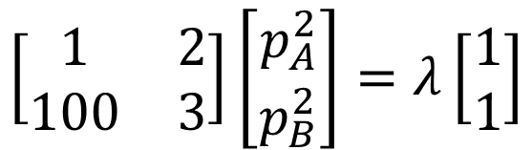
Finding Nash Equilibria in General
Support Enumeration Example:
Suppose we choose a support of $\{1,2\}$ for Player 1 and $\{A,C\}$ for Player 2
The indifference equations:
$$\left[\begin{matrix}1 & 2 \\ 100 & 3\end{matrix}\right]\left[\begin{matrix}p_{A}^{2} \\ p_{B}^{2}\end{matrix}\right]=λ\left[\begin{matrix}1 \\ 1\end{matrix}\right]$$
20
30
2
1
-10
100
$$p_{A}^{2}+p_{B}^{2}=1$$
-10
-20
100
20
1
3
$$\left[\begin{matrix}p_{1}^{1} & p_{2}^{1}\end{matrix}\right]\left[\begin{matrix}−1 & −2 \\ −100 & −3\end{matrix}\right]=μ\left[\begin{matrix}1 \\ 1\end{matrix}\right]$$
$$p_{1}^{1}+p_{2}^{1}=1$$

Slide 15






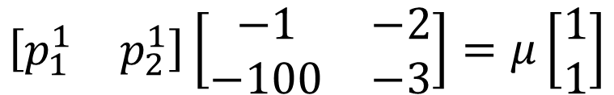

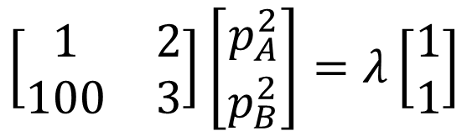

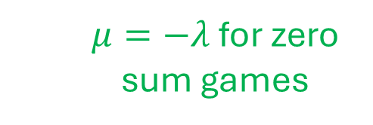
Finding Nash Equilibria in General
Support Enumeration Example:
Suppose we choose a support of $\{1,2\}$ for Player 1 and $\{A,C\}$ for Player 2
Solving the indifference equations, we get:
Invalid Solution
$$\left[\begin{matrix}1 & 2 \\ 100 & 3\end{matrix}\right]\left[\begin{matrix}p_{A}^{2} \\ p_{B}^{2}\end{matrix}\right]=λ\left[\begin{matrix}1 \\ 1\end{matrix}\right]$$
$$p_{A}^{2}=−1/98$$
$$p_{B}^{2}=99/98$$
$$p_{A}^{2}+p_{B}^{2}=1$$
$$λ=197/98$$
$$\left[\begin{matrix}p_{1}^{1} & p_{2}^{1}\end{matrix}\right]\left[\begin{matrix}−1 & −2 \\ −100 & −3\end{matrix}\right]=μ\left[\begin{matrix}1 \\ 1\end{matrix}\right]$$
$$p_{1}^{1}=97/98$$
$$p_{2}^{1}=1/98$$
$$p_{1}^{1}+p_{2}^{1}=1$$
$μ=−λ$ for zero sum games
$$μ=−197/98$$

Slide 16
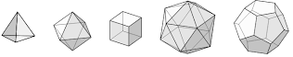

Zero Sum Game with $m$ x $n$ Payoff Matrix
2. Vertex Enumeration
We represent the possible payoffs for Player 1 and Player 2 through polytopes
Since the Nash equilibrium must be on a vertex, we iterate through all possible pairs of fully labeled vertices (one from each polytope)
A pair of vertices is fully labeled if they satisfy the Strong Minimax Theorem:
Either $\sum_{i=1}^{m}{p_{i}^{1∗}Π_{ij}=V}$ or $p_{j}^{2∗}=0$ for all $j$
Either $\sum_{j=1}^{n}{Π_{ij}{(p_{j}^{2∗})}^{T}=V}$ or $p_{i}^{1∗}=0$ for all $i$

Slide 17
Zero Sum Game with $m$ x $n$ Payoff Matrix
How do we solve zero sum games in general?
The Python library nashpy has three methods of finding equilibria:
3. Lemke Howson Algorithm
Very efficient but not guaranteed to find all of the Nash equilibria

Slide 18
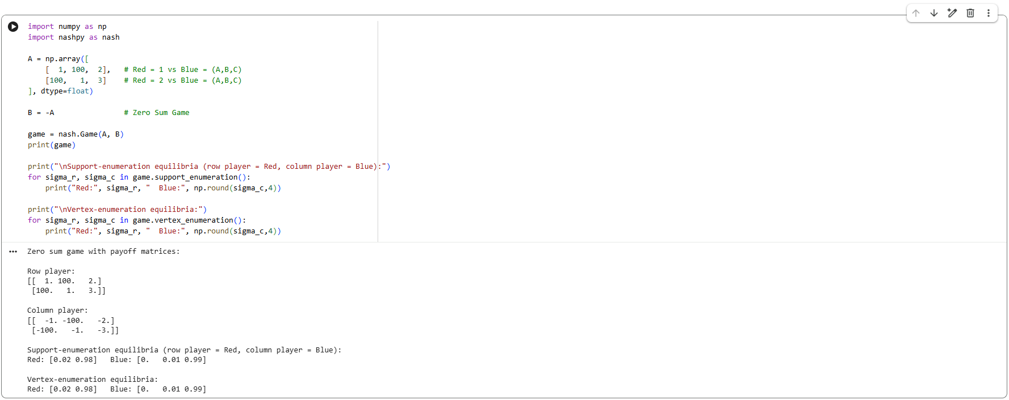
Sample NashPy Code

Slide 19
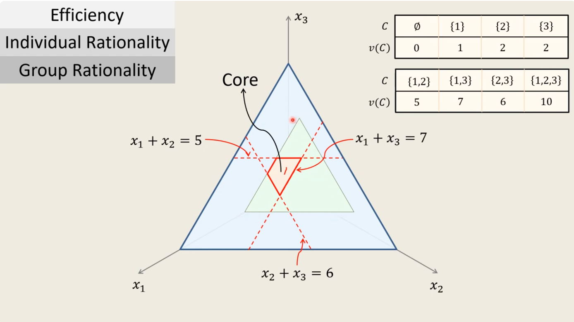
Imputations and
von Neumann-Morgenstern solutions

Slide 20

Cooperative Games with Side Payments
Instead of considering individual payoff functions, we only need to consider the total coalition payoff given by the value function and the division of coalition payoff specified by the imputation
The value function maps a set of players (“a coalition”) to a payoff
The imputation determines how much of the payoff each coalition member gets

Slide 21
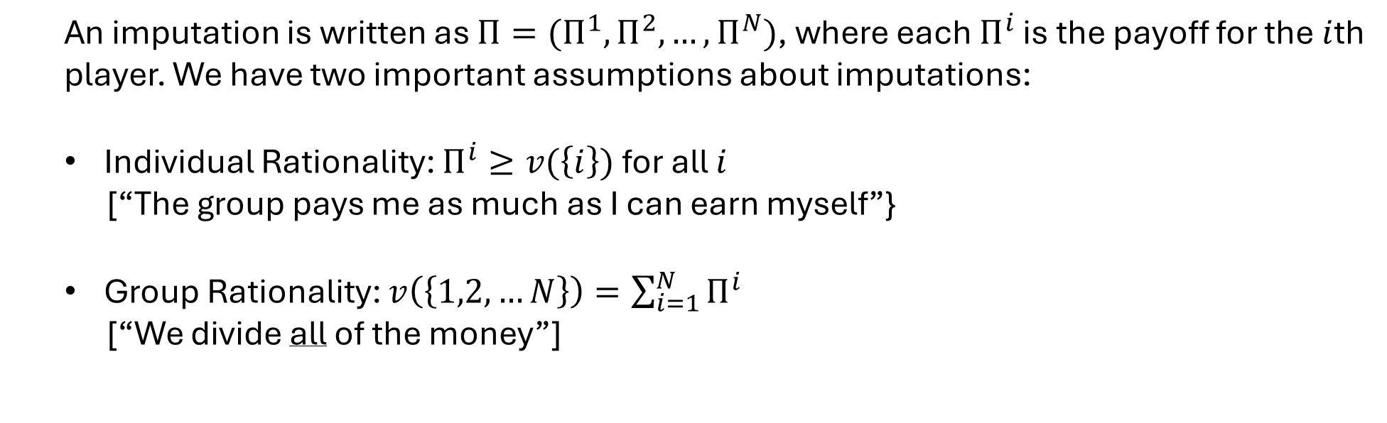
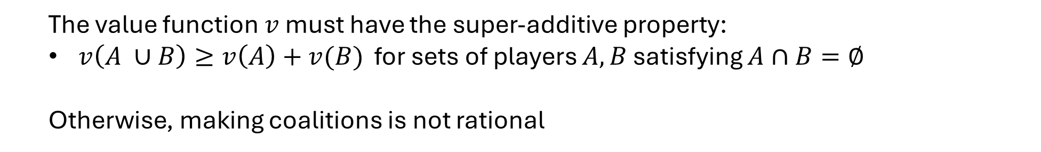
Value Functions and Imputations
The value function $v$ must have the super-additive property:
$v\left(A ∪B\right)≥v\left(A\right)+v(B)$ for sets of players $A,B$ satisfying $A∩B=∅$
Otherwise, making coalitions is not rational
An imputation is written as $Π=(Π^{1},Π^{2},…,Π^{N})$, where each $Π^{i}$ is the payoff for the $i$th player. We have two important assumptions about imputations:
Individual Rationality: $Π^{i}≥v(\left\{i\right\})$ for all $i$
[“The group pays me as much as I can earn myself”}
Group Rationality: $v\left(\left\{1,2,…N\right\}\right)=\sum_{i=1}^{N}{Π^{i}}$
[“We divide all of the money”]

Slide 22
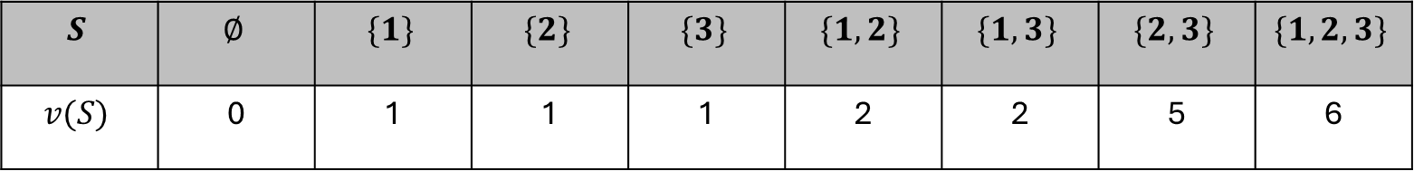
Sub-Coalitions
Even with individual and group rationality, some imputations may encourage
sub-coalitions to form
Example Suppose we have three players (1,2,3) and the following value function:
$$S$$ | $$∅$$ | $$\{1\}$$ | $$\{2\}$$ | $$\{3\}$$ | $$\{1,2\}$$ | $$\{1,3\}$$ | $$\{2,3\}$$ | $$\{1,2,3\}$$
$$v(S)$$ | 0 | 1 | 1 | 1 | 2 | 2 | 5 | 6
The imputation $[2,2,2]$ is rational from an individual and group perspective
But Players 2 and 3 would benefit by breaking off and forming their own sub-coalition

Slide 23
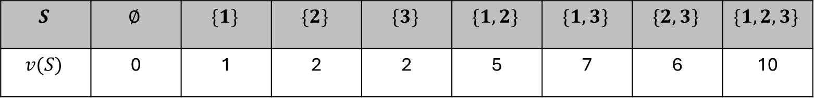

The Core
The core is the set of imputations which are
individually rational
group rational
have no preferable sub-coalitions
Example Suppose we have three players (1,2,3) and the following value function:
$$S$$ | $$∅$$ | $$\{1\}$$ | $$\{2\}$$ | $$\{3\}$$ | $$\{1,2\}$$ | $$\{1,3\}$$ | $$\{2,3\}$$ | $$\{1,2,3\}$$
$$v(S)$$ | 0 | 1 | 2 | 2 | 5 | 7 | 6 | 10
If the imputation $[x_{1},x_{2},x_{3}]$ is the core, then:
Individually rationality $⇒ x_{1}≥1,x_{2}≥2,x_{3}≥2$
Group rationality $⇒ x_{1}+x_{2}+x_{3}=10$
No preferable sub-coalitions $⇒ x_{1}+x_{2}≥5,x_{1}+x_{3}≥7,{x_{2}+x}_{3}≥6$

Slide 24
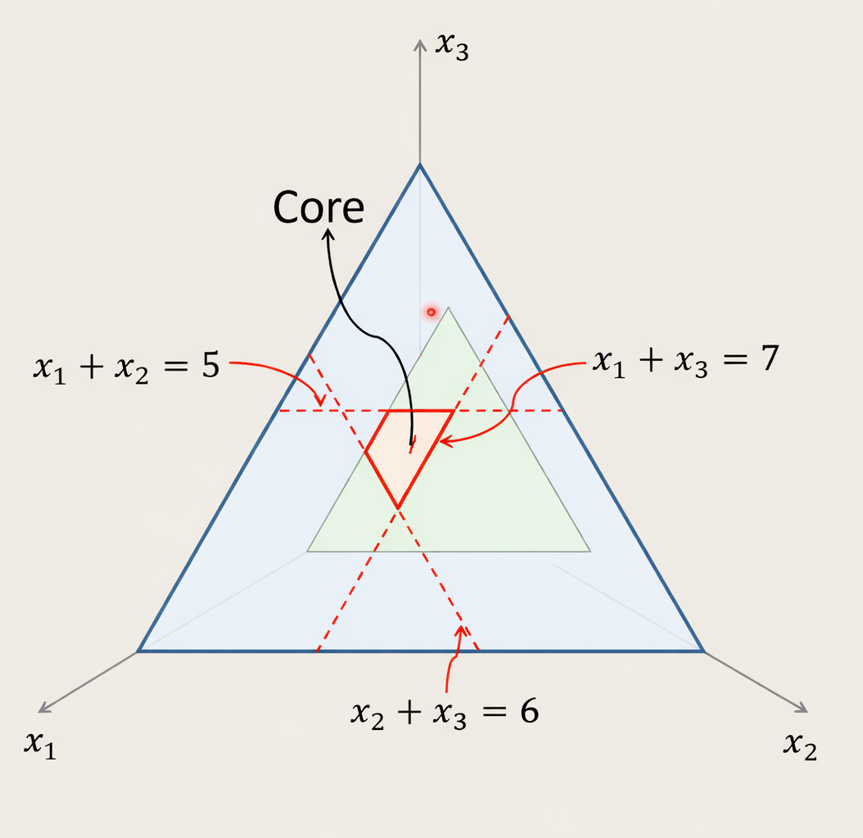
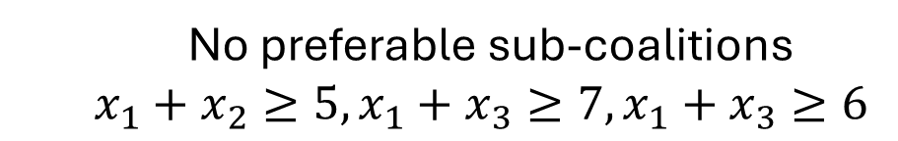
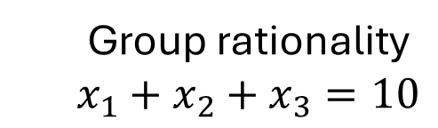
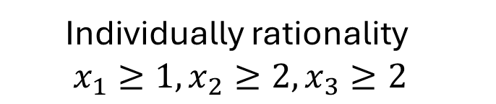
The Core
Group rationality
$$x_{1}+x_{2}+x_{3}=10$$
Individually rationality $x_{1}≥1,x_{2}≥2,x_{3}≥2$
No preferable sub-coalitions
$$x_{1}+x_{2}≥5,x_{1}+x_{3}≥7,{x_{1}+x}_{3}≥6$$

Slide 25
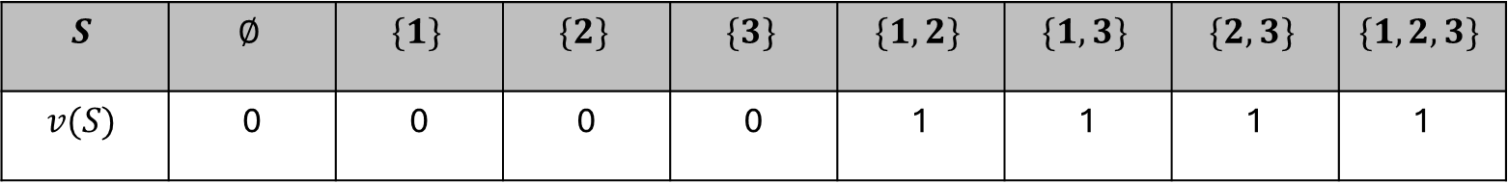

The Core
Note that the Core may be empty for some games
“Simple Majority” Example Suppose we have three players (1,2,3) and the following value function:
$$S$$ | $$∅$$ | $$\{1\}$$ | $$\{2\}$$ | $$\{3\}$$ | $$\{1,2\}$$ | $$\{1,3\}$$ | $$\{2,3\}$$ | $$\{1,2,3\}$$
$$v(S)$$ | 0 | 0 | 0 | 0 | 1 | 1 | 1 | 1
Group rationality: $x_{1}+x_{2}+x_{3}=1$
No preferable sub-coalitions: $x_{1}+x_{2}≥1,x_{1}+x_{3}≥1,{x_{1}+x}_{3}≥1$
$$⇒ 2x_{1}+2x_{2}+2x_{3}≥3$$
$$⇒2≥3$$
A Contradiction

Slide 26
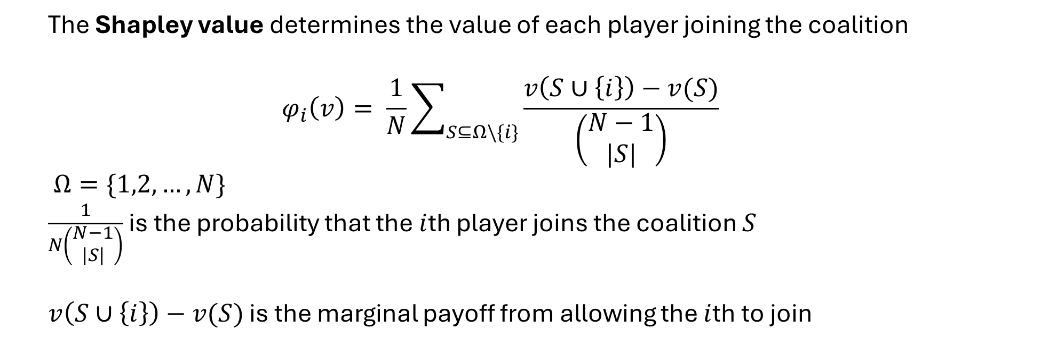
Shapley Values
The Shapley value determines the value of each player joining the coalition
$$φ_{i}\left(v\right)= \frac{1}{N}\sum_{S⊆Ω\backslash \{i\}}{\frac{v\left(S∪\left\{i\right\}\right)−v(S)}{\left(\begin{matrix}N−1 \\ |S|\end{matrix}\right)}}$$
$Ω=\{1,2,…,N\}$
$\frac{1}{N\left(\begin{matrix}N−1 \\ |S|\end{matrix}\right)}$ is the probability that the $i$th player joins the coalition $S$
$v\left(S∪\left\{i\right\}\right)−v(S)$ is the marginal payoff from allowing the $i$th to join
The Core converges to the Shapley value as $N →∞$ with negligible players

Slide 27
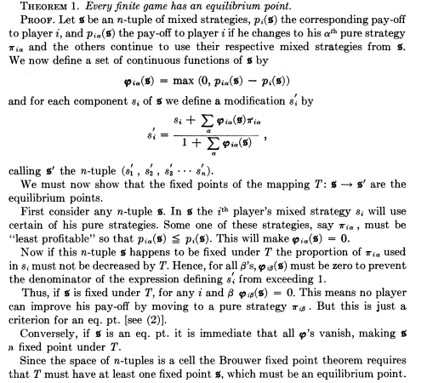
Nash’s Existence Proof

